Slide 1
Cortex M4 Floating point Unit
Girish S Kumar

Slide 2

Why do we need floating point ?
Floating point number representation specifies some way of encoding a
number, usually as a string of digits.
A floating-point system can be used to represent a number with a fixed number of digits, numbers of different orders of magnitude:
Distance between galaxies
Diameter of an atomic nucleus
Floating point is the formulaic representation that approximates a real number so as to support a trade-off between range and precision.

Slide 3
Cortex M4 FPU
In the Cortex-M4 MCU, an optional floating-point unit (FPU)
By default, the FPU is disabled and must be enabled prior to the
execution floating-point
If a floating-point instruction is executed but the FPU is disabled, a
No Co-Processor (NOCP) usage fault is generated.
FPU can work within the Normal Main thread as well as interrupt
Handler mode

Slide 4
What does FPU do ?
FPU supports half- and single-precision
Add,
Subtract,
Multiply,
Divide,
Multiply and accumulate,
Square root operations.
It provides conversions between fixed-point and floating-point data formats, as well as floating-point constant instructions.
It also supports the half-precision and single-precision floating-point formats to provide different manipulations for the floating-point data with the different lengths and accuracies.

Slide 5
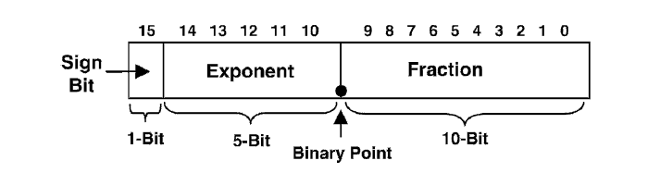
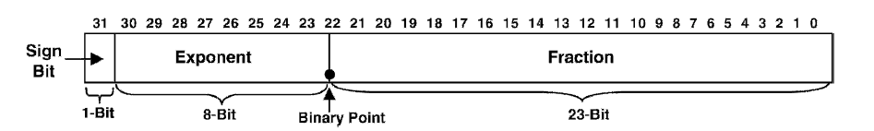
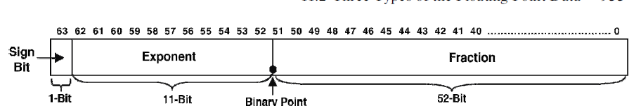
Types of Floating Point Data IEEE 754 standard
The half-precision floating-point format (16-bit data)
The single-precision floating-point format (32-bit data)
The double-precision floating-point format (64-bit data)

Slide 6
How is exponent & fraction used to generate the fraction ?
The 1-bit Sign field is used to determine the polarity of the floating-point number. A value of 0 on this bit indicates that this floating point number is a positive one, but a value of 1 means that this floating-point number is a negative number.
The 5-bit Exponent field is a biased exponent value. This means biased value of 15 must be subtracted from this biased exponent, to get the real or the true exponent value for the given floating-point number. The reason for using this biased exponent is to enlarge the range of the floating-point numbers.
The 10-bit Fraction field contains 10-bit binary significant bits (significands) after the decimal point. The key is that between the bit 10 and bit 9, or between the Exponent and the Fraction fields, a binary point exists and this must be kept in mind when converting this half-precision floating-point number to its real value.

Slide 7
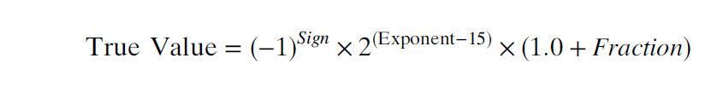
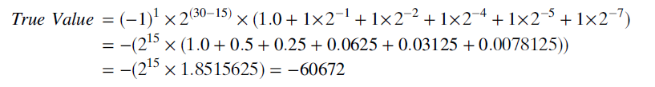
True value of fraction
An example take the number 1111101101101000.
The Sign bit is 1, which means that this is a negative floating-point number.
The biased exponent, Exponent, is 11110B = 30D,
The Fraction is 1101101000B.
Bias Exponent
Fraction
1 | 1 | 1 | 1 | 1 | 0 | 1 | 1 | 0 | 1 | 1 | 0 | 1 | 0 | 0 | 0

Slide 8
How to convert it back
1. Convert 60672 to hexadecimal or binary number, which is ED00 or
1110 1101 0000 0000.
2. Convert this binary number to the normalized format, which is 1.1101101×2¹⁵.
This is equivalent to moving the binary point to the left by 15 bits.
3. Convert the normal exponent 15 to the biased exponent, Exponent, by adding
the bias value 15. The biased exponent, Exponent, is 15+15=30D (11110B).
4. The Fraction is the significant bits after the decimal point, 1101 101 000. The tailed
zeros can be added to make this Fraction become 10 bits.
5. Add the Sign bit 1 to the bit 15 since this is a negative number.
6. The final IEEE 754 standard half-precision floating-point format for this number is
Sign-Bit, 1; Exponent, 11110; Fraction, 1101101000. Together it is
1 11110 1101101000.

Slide 9
Links to Use while working with floating point
http://babbage.cs.qc.cuny.edu/IEEE-754.old/32bit.html
https://www.h-schmidt.net/FloatConverter/IEEE754.html

Slide 10


Equation for Single Precession (32 Bit)
Equation for Double Precession (64 Bit)

Slide 11
Floating Point Processing
R0
S0
D0
R1
S1
R2
S2
D1
R3
Low Registers
S3
R4
R5
General
Purpose
Registers
R6
R7
R8
S30
D15
R9
S31
R10
High Registers
R11
R12
Special Purpose Registers
R13(SP)
MSP
PSP
PSR
Program Status Register
R14 (LR)
Banked Version
PRIMASK
R15(PC)
FAULTMASK
Exception Register
32 single-precision floating-point registers (s0–s31) or 16 double-precision
registers (d0–d15) or a mix
BASEPRI
CONTROL
Control Register

Slide 12
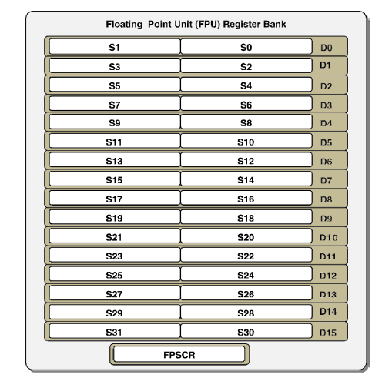
Floating Point Registers
Floating-Point
Data
Processing
Registers
(FPDPR)
Floating-Point
Status and
Control
Register
(FPSCR).

Slide 13
FPU Registers
Cortex-M4 has a difference set of register file made up of 32 single-precision registers labeled s0 to s31.
None of the FPU registers are banked, unlike ARM registers
No limitation of on usage of registers (line R13, R14, R15)
The FPU registers are aliased, such that two single-precision registers may be referenced as a double-precision register. [D0 to D15]

Slide 14

Floating point Status and Control Register

Slide 15
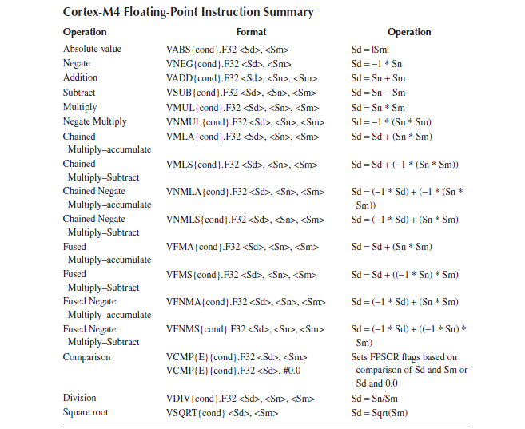

Slide 16
Flags in FPSCR
Flags in FPSCR can be changed only by two instructions :
VCMP
VCMPE
These do a subtract first operand from second and update flags but not
Results.
There are not S variants for Floating point instructions
Meaning of C and V flags are redefined to indicate one or both operands in VCMP or VCMPE is NaN

Slide 17

What is NaN

Slide 18
Not A Number ?
Not a Number is a data type used for representing UNDEFINED Values
This concept was introduced during 1985 in IEEE 754 floating standard to represent quantities like infinites
Example of NaN are:
Zero /Zero
Root of a negative number Sqr-root(-1)
Infinity is slightly different from NaN
Just like imaginary number Sqr-root(-1) is used to build the concept of Complex numbers
and used to solve many complex engineering problems , NaN do have significance in
Floating point operation in Computing
>>> inf = float("9e999")
>>> inf - inf

Slide 19
Operations with NaN
There are different kinds of operations that can return NaN:
Operations with a NaN as at least one operand.
Intermediate Form
The divisions 0/0 and ±∞/±∞.
The multiplications 0×±∞ and ±∞×0.
The additions ∞ + (−∞), (−∞) + ∞ and equivalent subtractions.
The standard has alternative functions for powers:
The standard pow function and the integer exponent pown function define 0⁰, 1∞, and ∞⁰ as 1.
The powr function defines all three indeterminate forms as invalid operations and so returns NaN.
Real operations with “imaginary” Results
The square root of a negative number.
The logarithm of a negative number.
The inverse sine or cosine of a number that is less than −1 or greater than +1.

Slide 20
How are NaNs Represented
As per IEEE 754 a NaN is represented as
Exponent field all filled with ONES
A non-zero number in the Fraction (to make them distinct from infinity values)
Sign Bit has the same meaning
This representation allows the definition of multiple distinct NaN values, depending on which bits are set in the Fraction , but also on the value of the leading sign bit
Exponent
Fraction
1 | 1 | 1 | 1 | 1 | 1 | 0 | 1 | 0 | 1 | 1 | 0 | 1 | 0 | 0 | 0
Exponent = 0x1F ➔ 11111

Slide 21
How are NaNs Represented
When Exponent, is equal to 0x1F (11111), the following possible results
exist:
• If the Fraction is 0 and the Sign bit is also 0, then the true value is infinitive (+ Infinity).
• If the Fraction is 0 and the Sign bit is 1, then the true value is infinitive (- Infinity).
• If the Fraction is not 0, then it is a special code or known as NaN (Not a Number).
Some bits from x (usually and preferably the first one) are used to determine the type of NaN:
Quiet NaN (qNaNs), do not raise any additional exceptions as they propagate through most operations.
Signaling NaN are special forms of a NaN that when consumed or processed by most operations should raise the invalid operation exception
TODO: Represent –infonty and + infinity as diagrams

Slide 22
Uses of NaN
Filling uninitialized memory with Signaling NaNs would produce the invalid operation exception if the data is used before it is initialized
Using an sNaN as a placeholder for a more complicated object, such as
A representation of a number that has underflowed
A representation of a number that has overflowed
Number in a higher precision format
A complex number

Slide 23
Comparison Instructions
VCMP
VCMPE
These do a subtract first operand from second and update flags but not
Results.
VCMPE | VCMP
Will set Invalid Flag if one of the operands is a NaN whether is sNaN or qNaN | Will set Invalid operation if either is a sNaN
First check for NaN and then comparison is made | First check for NaN and then comparison is made
Comparison with normal number with +Ve infinity will yield a greater than result | Comparison with normal number with +Ve infinity will yield a greater than result
Comparison with normal number with -Ve infinity will yield a less than result | Comparison with normal number with -Ve infinity will yield a less than result

Slide 24

What happens when Exponent takes different values
If the Exponent, is in the range 0<Exponent<0x1F, the value of the
true floating-point number is a normalized value and it can be calculated by using the
Equation
. If the biased exponent, Exponent, is ZERO , the following possible results exist:
• If the Fraction is 0 and the Sign bit is 0, then the true value is 0 (+0)
• If the Fraction is 0 but the Sign bit is 1, then the true value is also 0 (-0)
• If the Fraction is not 0, then the true value is a subnormal or a de-normalized value and its true value should be calculated by using Equation

Slide 25
What happens when Exponent as all ones ?

Slide 26
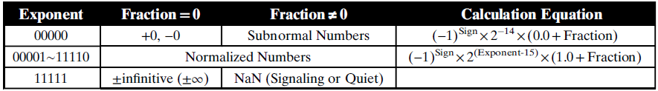
Summary

Slide 27
Question
How are Quiet NANs and Signaling NaNs
represented in 32 bit and 64 bit number ?

Slide 28
qNANs and Nan
A NaN value can be categorized into a signaling NaN or a quiet NaN, and this is defined as
1. If bit-9 of the Fraction is 0, it is a signaling NaN.
2. If bit-9 of the Fraction is 1, it is a quiet NaN.

Slide 29
Example of NaN getting Generated
area appcode, CODE, READONLY
export __main
ENTRY
__main function
VLDR.F32 s4, = 0
VLDR.F32 s5, = 0
VDIV.F32 s6,s5,s4
VLDR.F32 s5, = -1
VSQRT.F32 S7, S5
endfunc
end
7FC00000 -→ 0111 1111 1100 0000 0000 0000 0000 0000
7FC00000 -→ 0 1111 1111 10000000000000000000000

Slide 30


Slide 31
Floating-Point Loads and Stores: The Instruct ions
Memory is accessed in the same way for floating-point data and integer data. The instructions and the format for floating-point loads and stores is given below.
VLDR|VSTR{<cond>}.32 <Sd>, [<Rn>{, #+/ − <imm>}] VLDR|VSTR{<cond>}.64 <Dd>, [<Rn>{, #+/ − <imm>}]
VLDR{<cond>}.F32 Sd, =constant
VLDR{<cond>}.F64 Dd, =constant

Slide 32
The VMOV instruction
VMOV is used to move Data between ARM registers and Floating Point Unit
VMOV [<cond>].F32 <Sd>, <Rt>
VMOV[<cond>].F32 <Rt>, <Sn>
We can use VMOV to move data between FPU Registers
VMOV[<cond>].F32 < Sd>, <Sn>

Slide 33

Exception Handling

Slide 34
Division by Zero
When a division by Zero happens , the default result is a properly signed infinity.
This is indicated by DZC status bit in FPSCR
What is Positive infinity and negative Infinity ?
Recall the previous Discussion of NaN where the fractional part is ZERO
VMOV.F s0, #5.0
LDR r1, = 0x00000000 ; cannot load 0.0 using VMOV.F
VMOV.F s1, r1
VDIV.F s2, s0, s1 ; return positive infinity
VMOV.F s3, #-0.375
VDIV.F s4, s3, s1 ; return negative infinity
Results
S2 = 0x7F800000 → 0111 1111 1000 0000 0000 0000 0000 0000
S4 = 0x FF800000 → 1111 1111 1000 0000 0000 0000 0000 0000
Observe the Value of DZC bit FPSCR

Slide 35
Invalid Operation
Operations with signaling NaNs (sNANs)
Mathematical operations with unlike-signed infinities
Multiplication of infinity by zero.
Conversion operations— conversion of floating-point number to an integer or fixed-point format
When the Invalid Operation exception is detected for arithmetic and conversion operations, the default Quiet NaN (qNaN) is returned and the Invalid Operation (IOC) status bit is set in the FPSCR

Slide 36

Overflow
The Overflow exception is signaled when the result of an arithmetic operation cannot be represented because the absolute value of the result is too large for the destination format. In this way it is possible to overflow both with a positive and a negative result.
When an over flow happens both the overflow status bit (OFC) and
the inexact status bit (IXC) are set.
Modify the factorial program to work on Floating point and create an overflow

Slide 37

Under Flow
Floating-point arithmetic operations can also underflow when the result of the operation is too small to fit in the destination format. You can imagine when two very small values say 6.6261 × 10−34 (Planck’s constant in J ⋅ s) and 1.602 × 10−19 (elementary charge in Coulombs), are multiplied, the product is 10.607 × 10−53, but this value is outside the normal range of a single-precision value, and we have under flowed.
When the Underflow exception is detected, the default
value returned is a subnormal value (if the result is within the subnormal range for the destination precision) or a signed zero. The Underflow status bit (UFC) and the Inexact status bit (IXC) are set in the FPSCR if the result is not exact; otherwise, neither status bit is set.
Write a simple program using assembly language which results in UNDERFLOW

Slide 38
INEXACT Result
The result of an arithmetic operation on two floating-point values can have more significant bits than the destination register can contain. When this happens, the result is rounded to a value that the destination register can hold and is said to be inexact.
IT is not always possible floating-point computations to give exact results
Hence computation will result in an intermediate value which is between
two representable values and requires rounding.
This is when we say the result I inexact. That means simply that there was no representable value exactly matching the result, and another value was substituted for the computed result.
When the Inexact Exception occurs, the Inexact flag (IXC) is set in the FPSCR and the computation continues.

Slide 39
FPSCR
Covered

Slide 40

Flags in FPU and how they are used

Slide 41
FPU Flags
Flags | Description
N Flag | This Flag is set when the first operand in smaller than the second operand
Z Flag | This flag is set when the first operand == Second operand and they are no NaN
C Flag | The first is when the first operand is equal to or larger than the second operand, and the second is when either operand is NaN.
V Flag | The V flag is set only when a comparison is unordered, that is, when a NaN is one or both of the comparison operands.

Slide 42
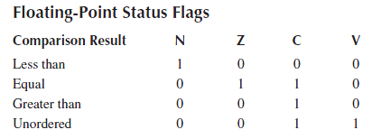
Summary of FPU Flags

Slide 43
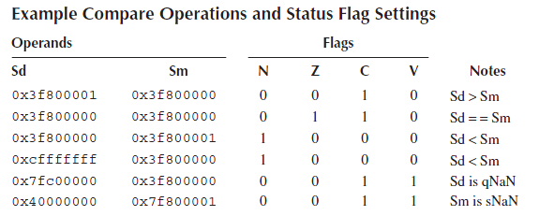

Slide 44
FPSCR
Covered
Covered
To be Discussed later
Default Nan Mode
When set to zero (Default) IEEE 754-2008 is selected

Slide 45
Research Assignment Due on
In Floating point representation we have three components
The Sign Bit
Exponent
Fractional Part
Precession is one the prime attribute of any Floating point Representation,
Does any of the above three components play a role in the defining the Precession of the number ? If so which are the component or Components which play the role in defining precession and how ? Explain this with example in your own words
What is Normal and Subnormal Values as per IEEE 754 standards explain this with the help of number line
IEEE 754vv defines standards for rounding floating points numbers to a represent able value. There are five methods defines by IEEE for this – Take time and understand what these five methods and explain it in your words using diagrams, illustrations of your own.
[For 1 to 3 Do not Copy paste from any published sources, including diagrams]

Slide 46
Arithmetic Instructions

Slide 47
Multiplication
Two multiply instructions are available in the Cortex-M4.
VMUL{cond}.F32 <Sd>, <Sn>, <Sm>
Multiplies two operands, writing the result in a destination register
VNMUL{cond}.F32 <Sd>, <Sn>, <Sm>
VNMUL first negates the second of the two operands before the multiplication

Slide 48
Multiply Accumulate
Cortex-M4 FPU implements a set of very accurate multiply–accumulate operations that called as to as fused Multiply-Accumulate. These set of instructions does not do rounding the results hence results in greater accuracy of results

Slide 49
VFMA | Fused Multiply–accumulate Sd = Sd + (Sn * Sm) | Temp = (Sn * Sm) Sd = Round(Sd + Temp)
VFMS | Fused Multiply Subtract Sd = Sd + ((−1 * Sn) * Sm) | Temp = Negate(Sn) Temp = (Temp * Sm) Sd = Round(Sd + Temp)
VFNMA | Fused Negate Multiply–accumulate Sd = (−1 * Sd) + (Sn * Sm) | Temp = (Sn * Sm) Temp2 = Negate(Sd) Sd = Round(Temp2 + Temp)
VFNMS | Fused Negate Multiply Subtract Sd = (−1 * Sd) + ((−1 * Sn) * Sm) | Temp = Negate(Sn) Temp = (Temp * Sm) Temp2 = Negate(Sd) Sd = Round(Temp2 + Temp)

Slide 50

Implementation of Exponential Series in Cortex –M4 Due on
In the next phase of the assignment we will see how to use this implementation as a
Library that can be used for building Machine Learning programs on a ARM processor .
Later you will learn how to write interface to this routine from high level language Like C

